Slide 1
Building a Quadcopter Using Android and Arduino
Prepared by
M. Khdiri A. Amir

Slide 2
INTRODUCTION
A quadcopter is an aircraft based on four propellers, quadcopters can be controlled by a radio transmission or operate under the guidance of limited autonomous protocols.
Arduino is an open-source system. Using Arduino is to decide by yourself which technologies and features you want to use into the quadcopter.
Android also is an open-source system, it is easy and low-cost to control the quadcopter flight with Android mobiles.

Slide 3
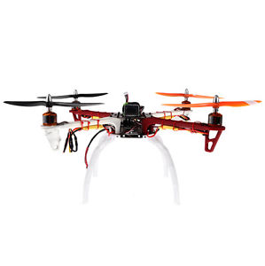
QUADCOPTER
Quadcopter, also known as quadrotor, is a helicopter with four rotors.
The rotors have equal distances from the center of the quadcopter, because of stabilization.
Quadcopter is classified as multi-copters, it is unmanned aerial vehicle (UAV).

Slide 4
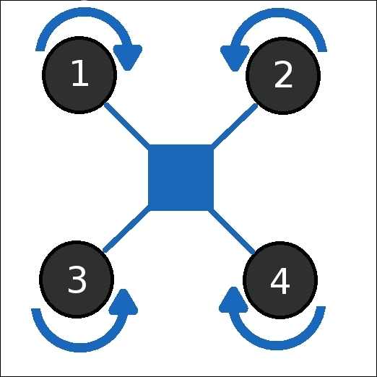
QUADCOPTER
Basic components of a quadcopter are frame, propellers, motors, electronic speed controllers (ESC), battery, and flight controller (FC).
The movement of the quadcopter is controlled by adjusting the angular velocity of the rotors that are rotated by electric motors.
The Propellers use two pairs to control the flight movement, one of them will spinning clockwise and the other counter-clockwise.

Slide 5
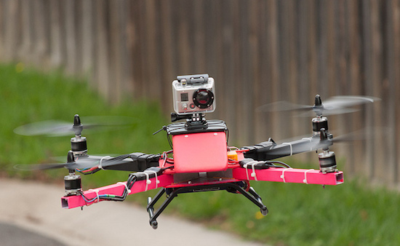
APPLICATIONS
Quadcopter can be used in military, surveillance, film making, search and rescue mission, because of having camera that can take photos and videos of places that human can’t go there.
Quadcopters can even save lives! ambulance drone will be sent quickly to the patient and it is used like some kind of medical emergency such as DC shock.

Slide 6
AIM OF THE PROJECT
The goal of this project is to build somehow self-reliant copter that can be capable to vertical lift, landing, moving forward/backward horizontally and hovering, and it can be able to stably rotating at one location. It has sensors to control flight and stability.

Slide 7

ARDUINO
Arduino is an open-source system based on easy-to-use hardware and software, it is a microcontroller-based kits.
Arduino has sets of digital and analog input/output pins.
It can be used with many other circuits and shields.
Arduino use the Arduino software that is an (IDE) based-on-Processing, that can support C and C++ programming languages.
It is inexpensive and it can be programmed on various platform including Windows, Mac OS X, or Linux.

Slide 8
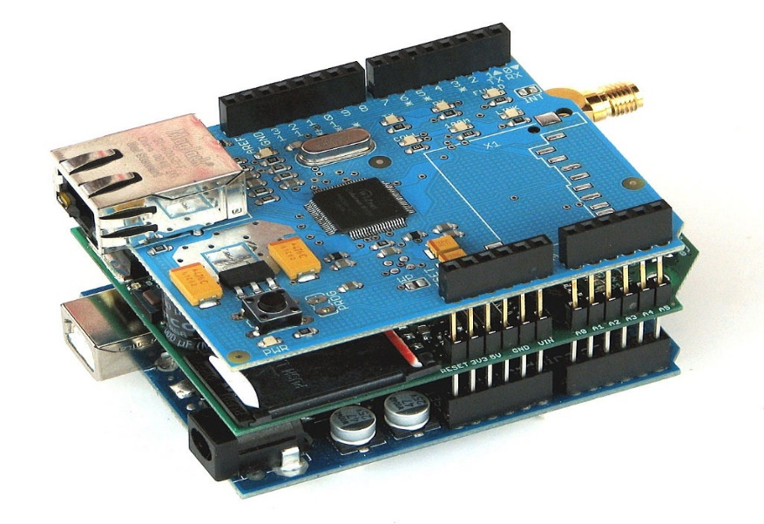
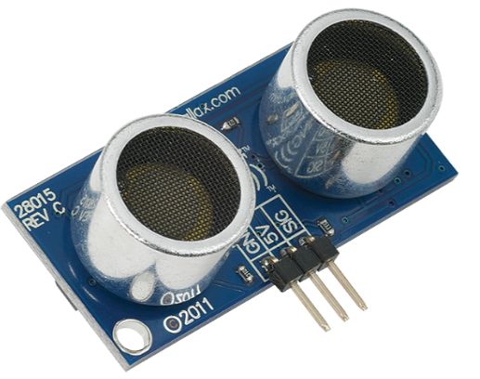
ARDUINO SHIELDS AND SENSORS
Arduino shields can provide many features, so Arduino can be expansion using shields.
Arduino shields: GPS, Ethernet, LCD, motor controls, Bluetooth, wireless, etc... And the shields can also be made DIY (Do it yourself).
Arduino projects can controlling its works by using sensors. Quadcopter can control its movements by using sensors.

Slide 9
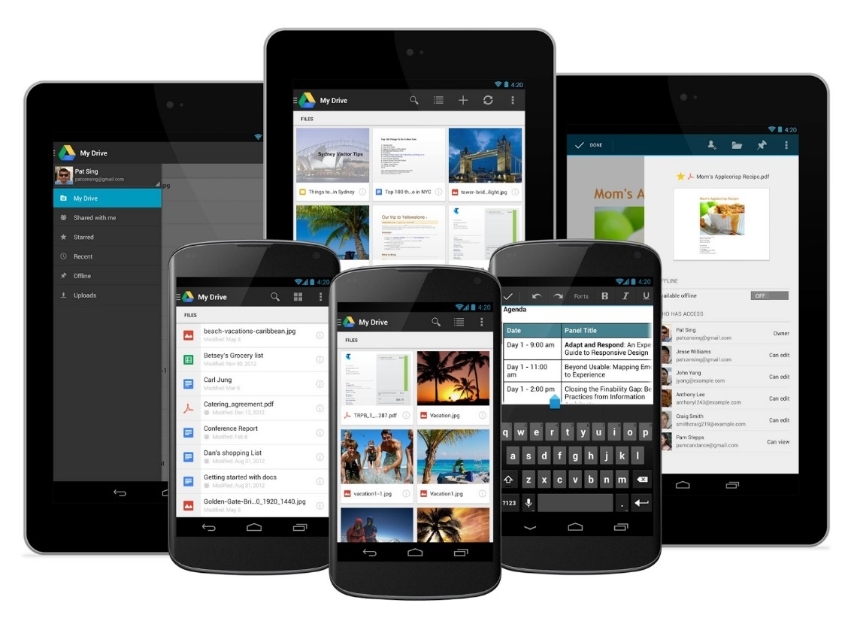
ANDROID SOFTWARE (REMOTE-CONTROLLER)
Android is an open-source system that has many applications.
Many developers work on open-source systems so it is cheap and easy to use.
Programming your own application for Android devices to controlling the quadcopter is a low-cost and easy.

Slide 10
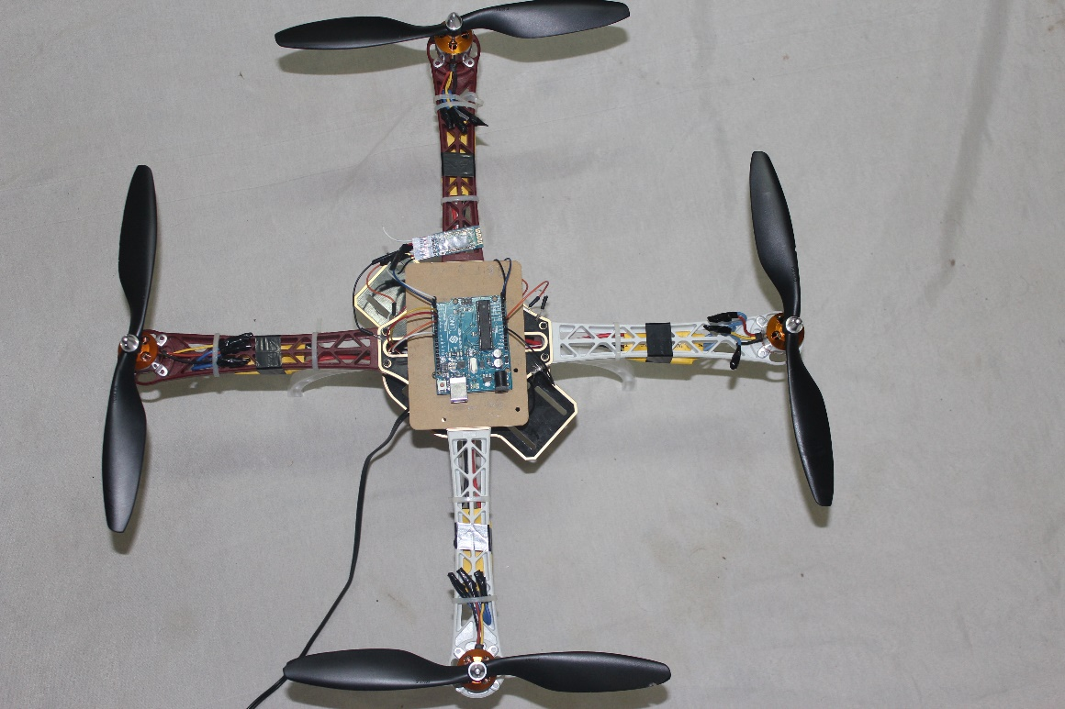
Quad-copter components
Frame
Propellers
Motors
Electronic speed controllers (ESC)
Battery
Flight controller (FC) and sensors

Slide 11
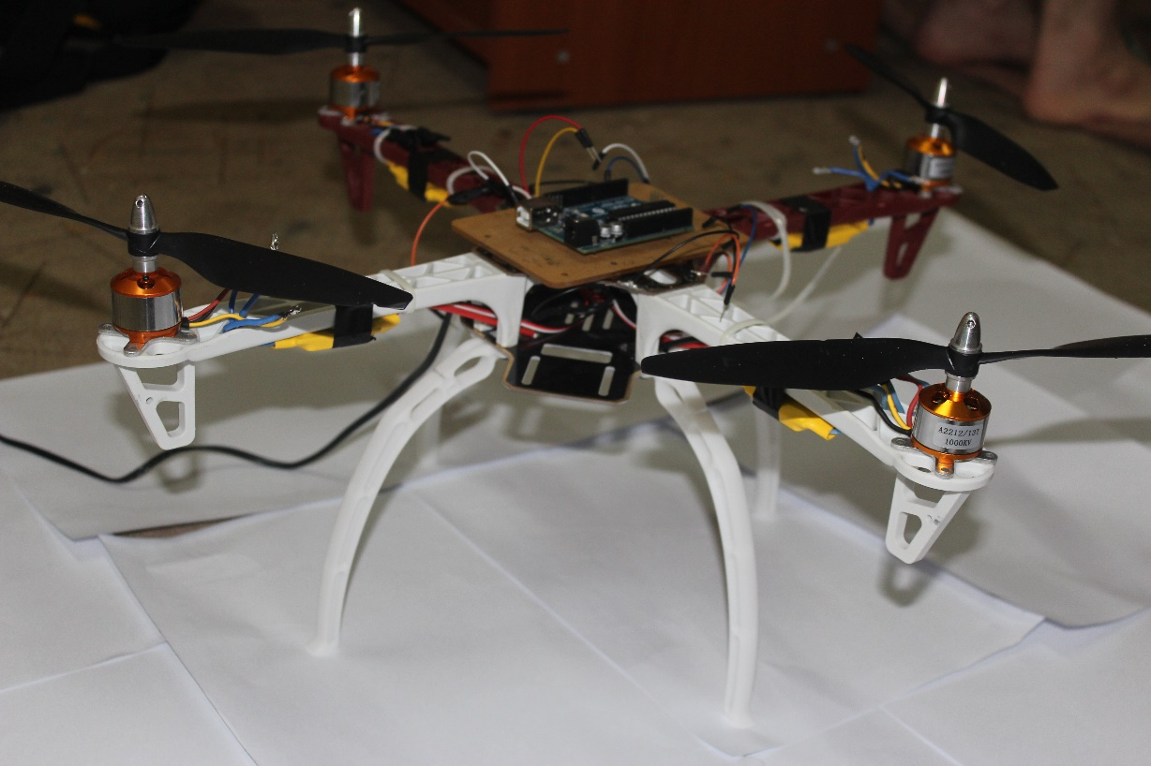
Frame
Every quad-copter needs a frame to house all the other components, what do you consider is the weight, size and materials.
we chose the RC FlameWheel F450.
made from the ultra-strong PA66+30GF material.
The weight of the frame with legs is 430 grams .
the size is 450 mm .

Slide 12
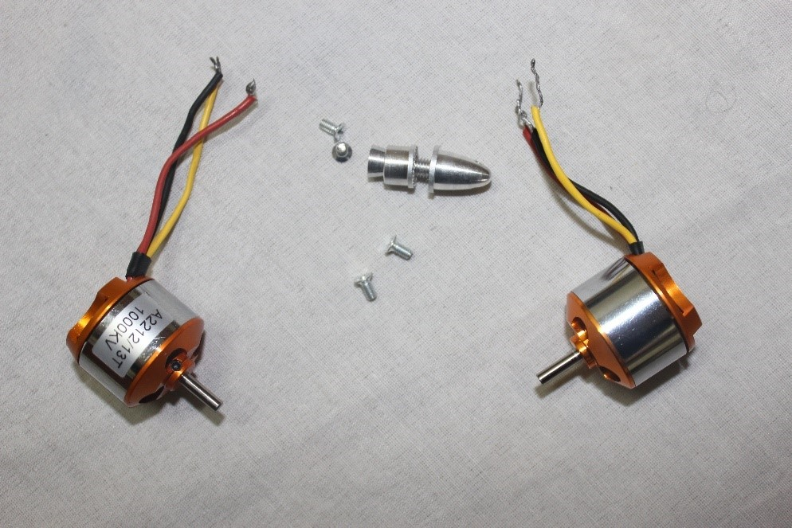
Motor
whole power system depends on motor
A rule of thumb is Required Thrust per motor = (Weight *2) / 4.
we use one of the brushless motors A2212-t13

Slide 13
Motor specification
Kv: | 1000 RPM/V
Max Efficiency: | 80%
Max Efficiency Current: | 4 - 10A (>75%)
No Load Current: | 0.5A @10V
Resistance: | 0.090 ohms
Max Current: | 13A for 60S
Max Watts: | 150W
Weight: | 48 g / 1.7 oz
Size: | 28 mm dia x 28 mm bell length
Shaft Diameter: | 3.17 mm
Poles: | 14

Slide 14
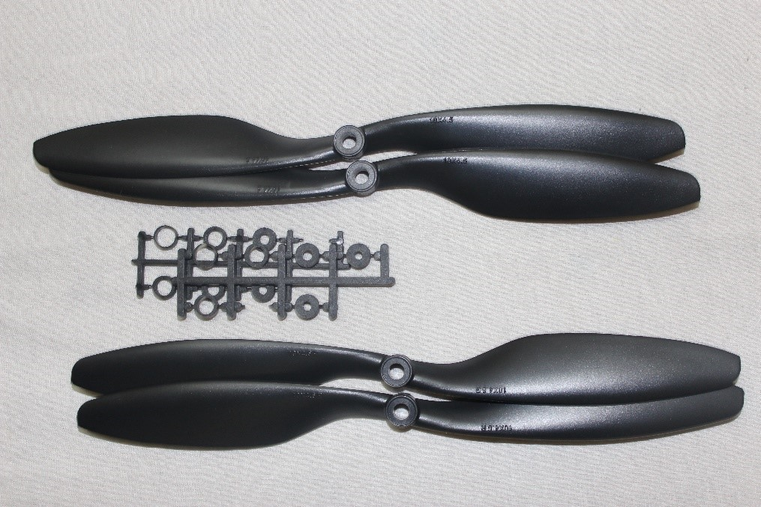
Propeller
This is perhaps the most important part.
Dimension 10 x 4.5 inch.
2 blades
2 each rotating CW and CCW .

Slide 15
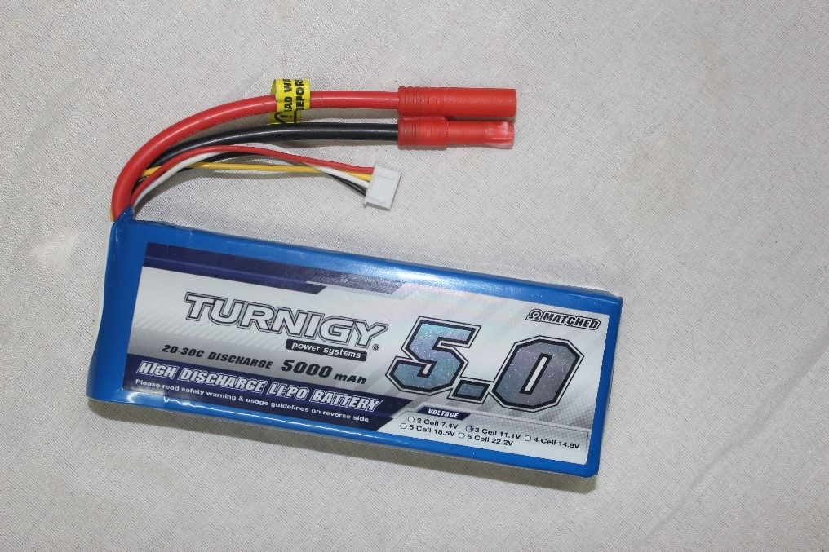
Battery
Larger battery allows for longer flight time.
We select 5000mAh 3 cell Lipo battery with a 20C rating.
maximum continuous amp (5.0 x 20) = 100A.
Minimum Capacity: 5000mAh Configuration: 3S1P / 11.1v / 3Cell Constant Discharge: 20C Peak Discharge (10sec): 30C Pack Weight: 412g

Slide 16
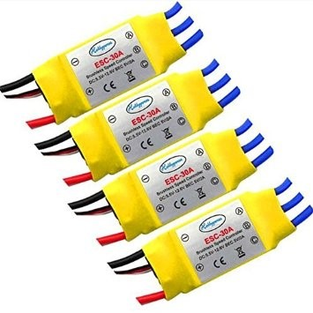
ESC
ESC stands for Electronic Speed Control.
Converts the battery pack DC voltage to a three phase alternating signal which is synchronized to the rotation of the rotor.
The motor speed is set by the ESC.
ESC should be higher than max amp rating of motor.

Slide 17
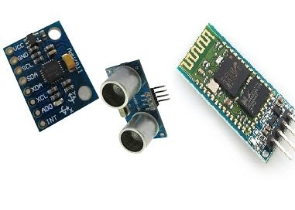
Flight controller (FC)
Flight controller is the Brain of your quadcopter .
we need at least six channels to control a quadcopter.
the Bluetooth HC-05 receiver and use smartphone as transmitter

Slide 18
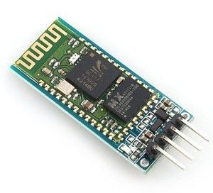
HC-05 Bluetooth
Bluetooth protocol: Bluetooth Specification v2.0.
Frequency: 2.4GHz ISM band.
Speed: Asynchronous: 2.1Mbps(Max) / 160 kbps, Synchronous: 1Mbps/1Mbps.
Security: Authentication and encryption.
Dimension: 26.9mm x 13mm x 2.2 mm.
Range is approximately 10 Meters (30 feet).

Slide 19
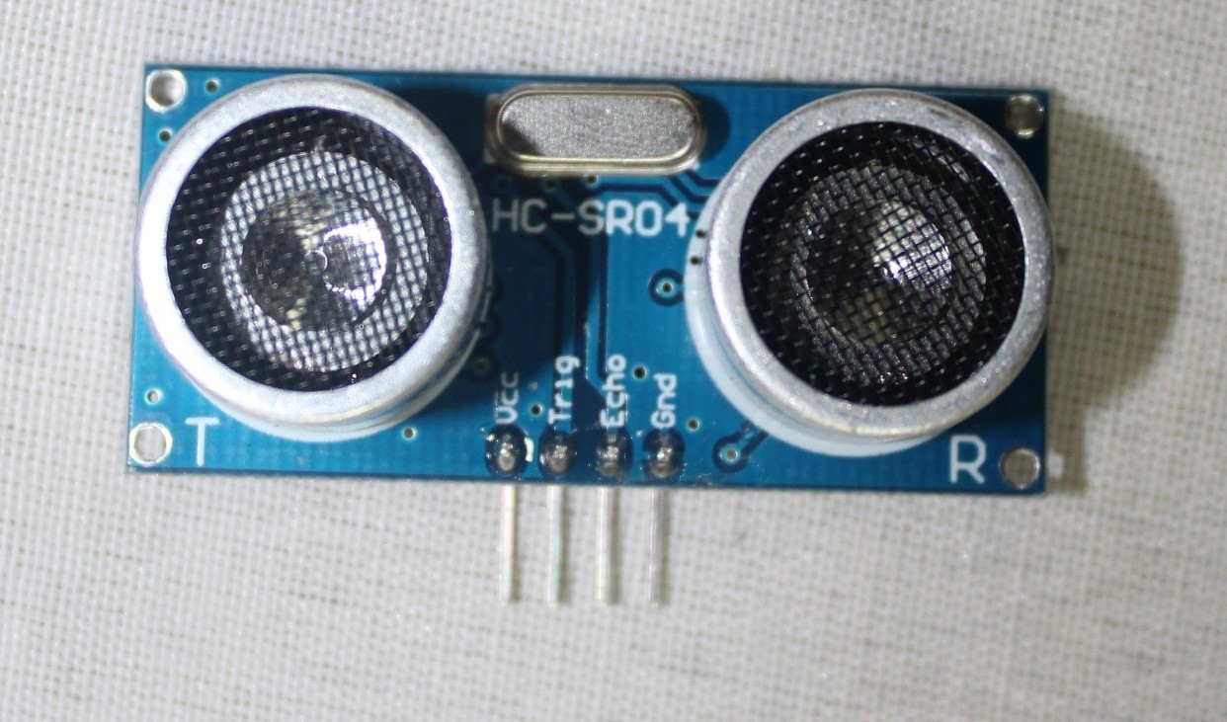
HC-SR04 ultrasonic distance sensor
avoid obstacles in indoor flights and a step closer to automating it.
Power: 5V DC.
Quiescent Current: <2mA.
Ranging Distance: 2cm – 500 cm/1" - 16ft.
LxWxH: 45 x 20 x 15mm.
Weight: 8.5g.

Slide 20
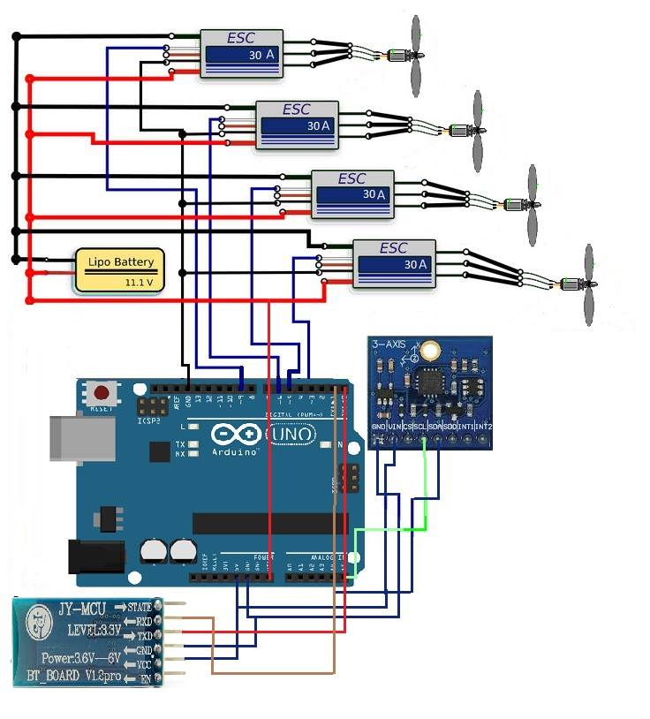
Hardware design

Slide 21
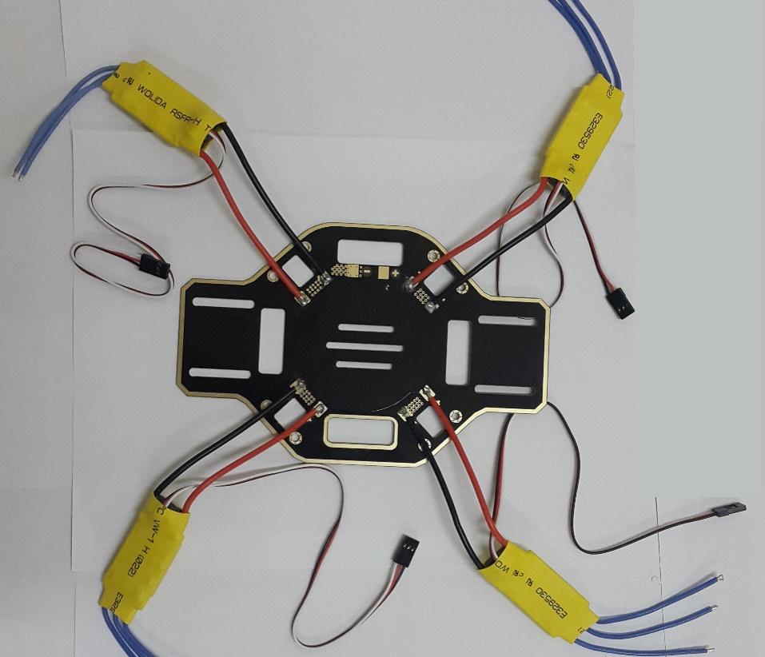
Join components
Join the ESCs to the Frame.
Join other frame parts together.
Then connect ESCs to the motors.

Slide 22
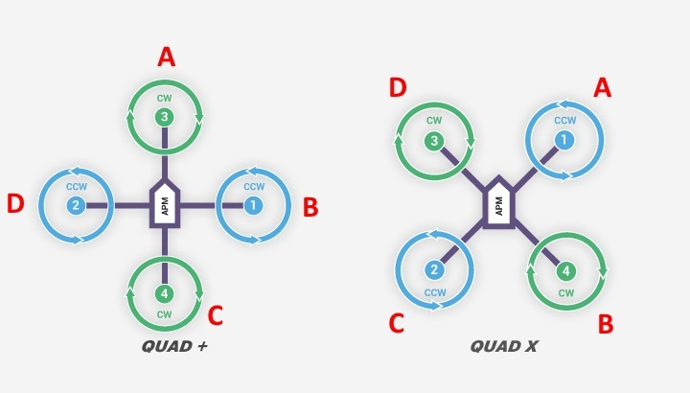
Quadcopter Shapes
We have two types of the shape of the frame; X-Shape and + Shape.
We use the X-Shape for designing our quadcopter. The first motor will be in (A) position, the second will be in (B) and proceed clockwise.
Motors must be in 2-pair, one of them clockwise and the other anti-clockwise.

Slide 23
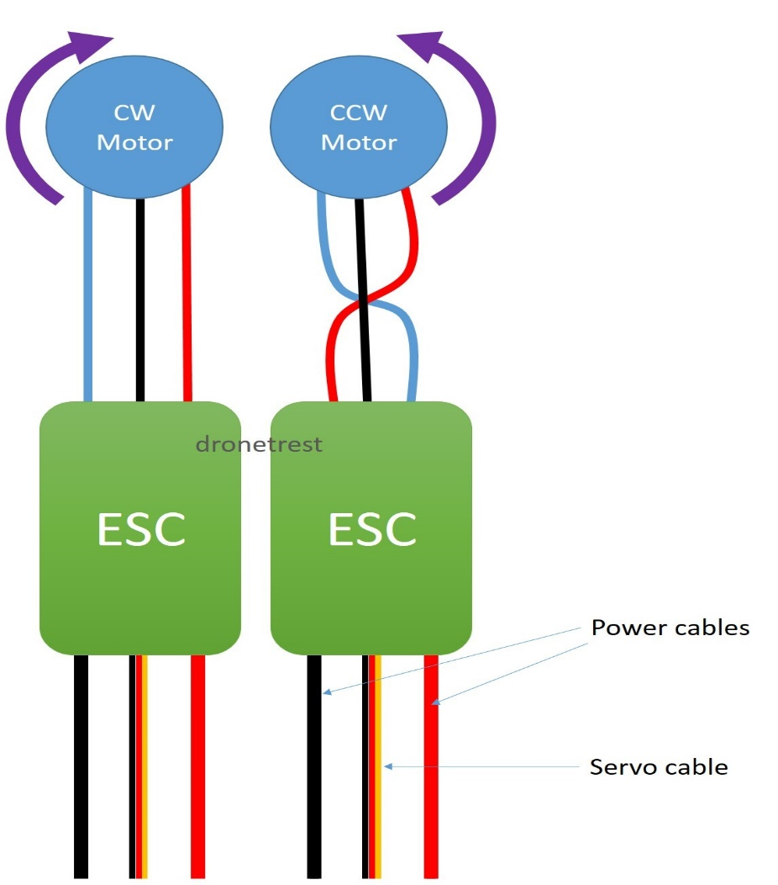
Clockwise and anti-clockwise
ESCs have three cables, the middle one is the received data and two others are power
cables, so as motors. So if we swipe the power cables we can control the rotation of the motor.

Slide 24
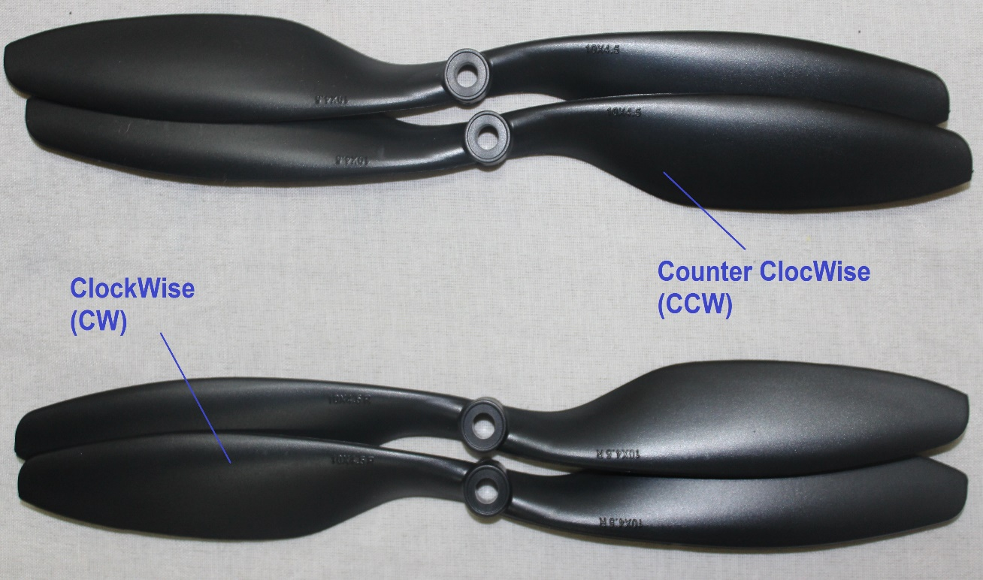
Propellers
Also propellers need to install in clockwise and counter clockwise.

Slide 25
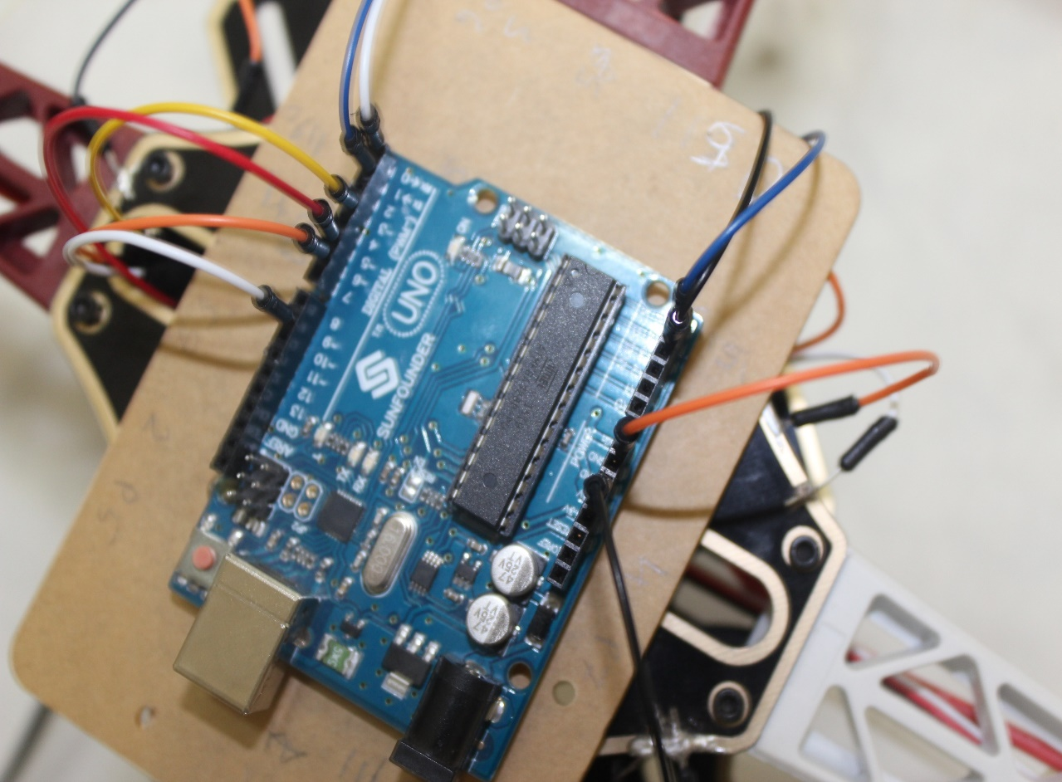
Connect them to Arduino
Arduino has not much volts (VCC) and grounds (GND).
but each ESC has its own VCC and GND, and the Gyro also need to have ground and voltage, so does Bluetooth and other sensors.
Connecting all grounds and volts together, solve this.

Slide 26
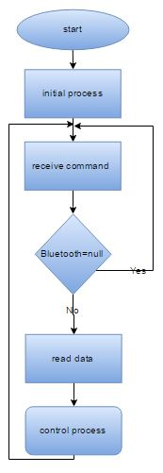
Software design
Arduino process
To maintain the stability and response to control command from receiver.

Slide 27
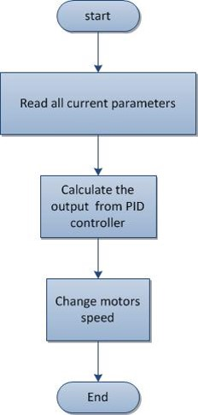
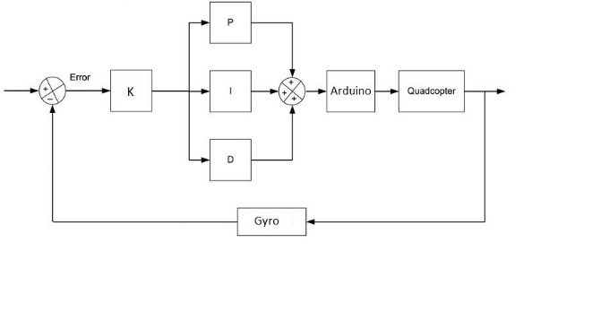
Control process

Slide 28
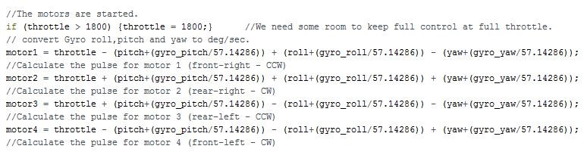
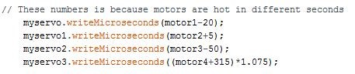
Change motor speed control

Slide 29
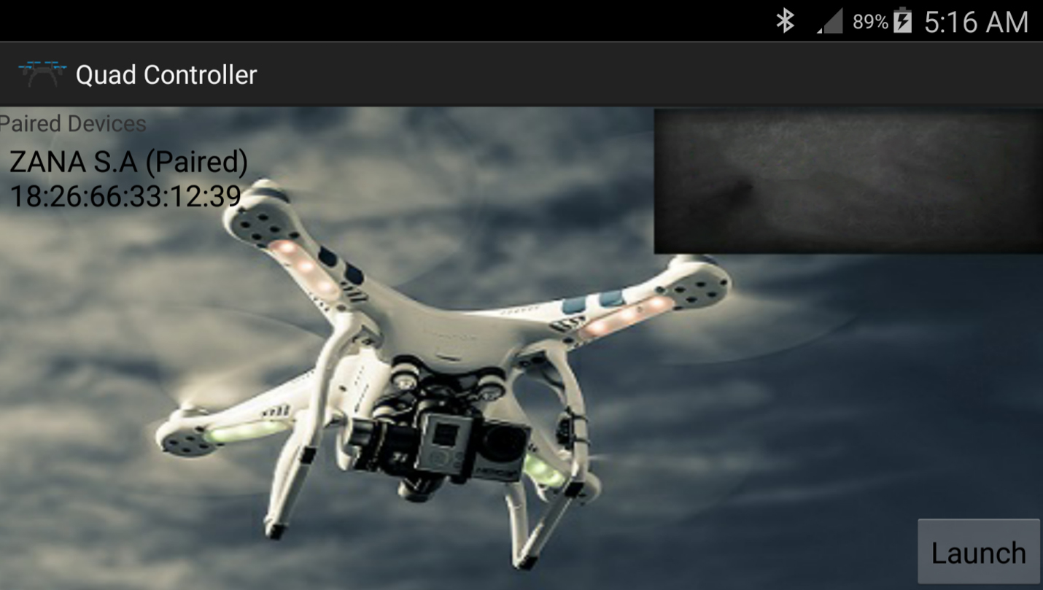
First frame

Slide 30
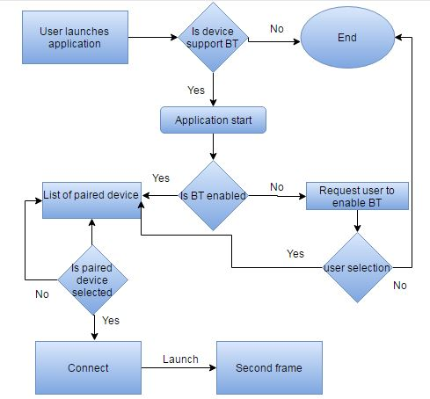
Connecting Bluetooth
Android Process
for Connecting to a receiver in Arduino

Slide 31
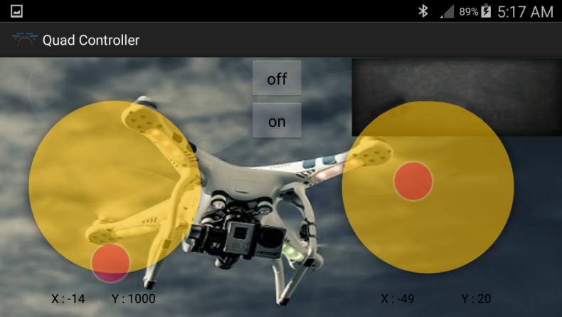
Second frame

Slide 32
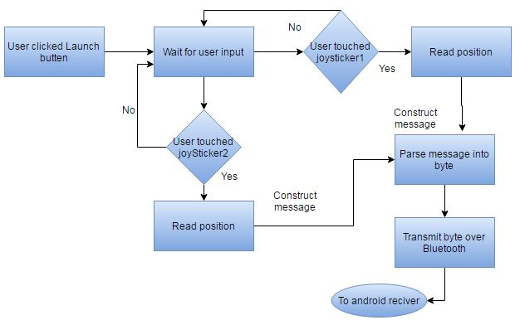
Reading User Input and Transmitting to arduino

Slide 33
Table of costs that we spent in our project
Object | cost | reason
Arduino UNO R3 with Kit | 47.84$ | Basic part (Board).
Turnigy LiPo battery 5000 MAH | 51.5 | Power the ESCs and motors.
Ultrasonic distance sensor | 10$ | Controlling lift.
4x motor +4x esc +4x propeller | 54.6$
Frame | 20.1$
Hc-05 Bluetooth | 7$ | To control the Quadcopter.
Gyroscope | 36.62$ | Stability.
Total cost | 278.16$

Slide 34
Thank you…!

